Slide 1
Topic:Fractions, decimals & percentages EQ: How do you convert between Fractions, decimals and Percentages?
Year 11 Essentials

Slide 2
Things Required For This Lesson
Interactive Notebook
Textbook: Interleaved Maths Essential Connections
Ruler, Red Pen, Pencil, Pens, Scientific Calculator
Growth mindset

Slide 3

24
7
30
Topic: Fractions, decimals and percentages
Date: 12/02/2021
EQ: How do you convert between Fractions, Decimals and Percentages?
WICOR
This Photo by Unknown Author is licensed under CC BY-SA

Slide 4

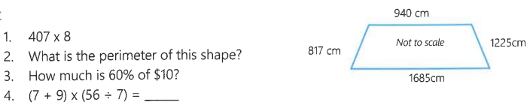
Interleave Questions set 3 page 134

Slide 5
Explore
%
$
cm
m
1. How many cents are in each dollar?
2. How many centimetres are in each metre?
3. How many years are in each century?
4. What do you think percent means?
5. What percent is equal to one whole?

Slide 6
24
7
30
Topic: Fractions, decimals and percentages
EQ: How do you convert between Fractions, Decimals and Percentages?
What is percentage?
Percentage is “per” “century”. It is a score out of 100
How do we convert percentages and decimals?
If you think of percentage as cents and decimals as dollars the conversion is the same.
EXAMPLE: $1=100 cents, 100%=1 50 cents is $0.50, so 50% is 0.5 as a decimal.
(Decimal to Percentage times by 100, percentage to decimal divide by 100)
How do we convert between Fractions and percentages?
Percentage is a score out of 100, so to convert to a fraction we put it over 100 and simplify
Fraction to decimal
Divide the numerator by the denominator (top divided by the bottom of the fraction)
WICOR

Slide 7
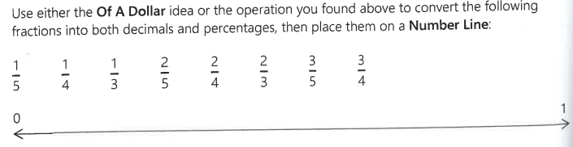
LHS
This is on page 18 of your text book

Slide 8
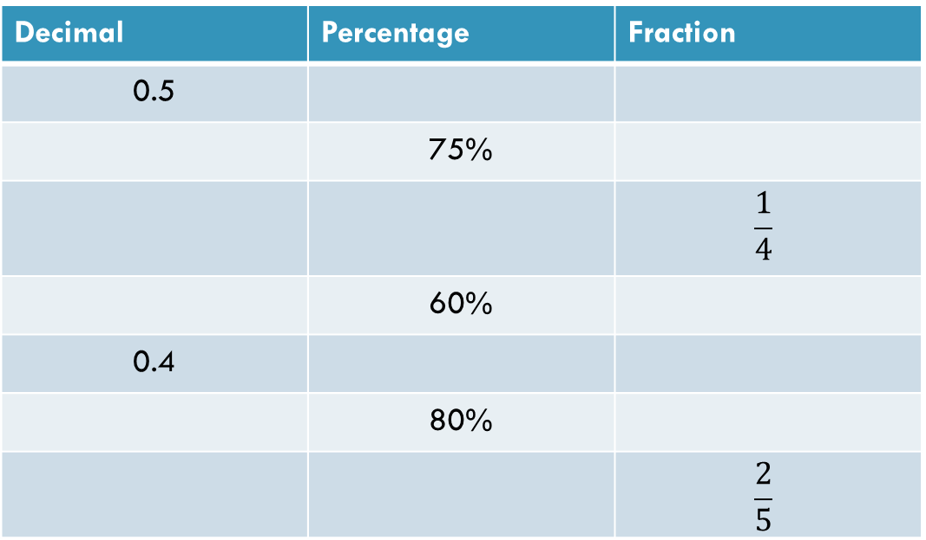
Copy and complete the table
Decimal | Percentage | Fraction
0.5
 | 75%
 |  | $$\frac{1}{4}$$
 | 60%
0.4
 | 80%
 |  | $$\frac{2}{5}$$
Notes:
Have post-it notes pre-prepared with -50, 25, 0, -75, 50, 75 for whole class display on the board

Slide 9
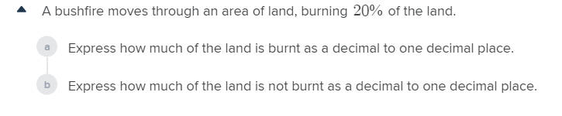
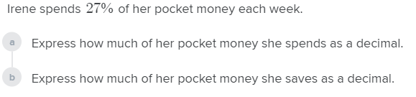
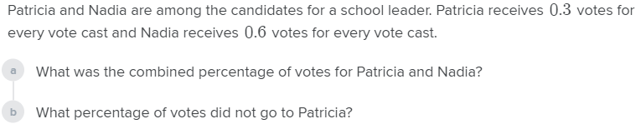
Worded problems

Slide 10

Thank you
Keep up the good work!
Quote of the day –
“Good, better, best.
Never let it rest,
until your good is better,
and your better is best”

